Slide 1
Point-to-Point Links
Outline
  Encoding
  Framing
  Error Detection
  Sliding Window Algorithm

Slide 2
Encoding
Signals propagate over a physical medium
  modulate electromagnetic waves
  e.g., vary voltage
Encode binary data onto signals
  e.g., 0 as low signal and 1 as high signal
  known as Non-Return to zero (NRZ)
Bits
0
0
1
0
1
1
1
1
0
1
0
0
0
0
1
0
NRZ

Slide 3
Problem: Consecutive 1s or 0s
Low signal (0) may be interpreted as no signal
High signal (1) leads to baseline wander
Unable to recover clock

Slide 4
Alternative Encodings
Non-return to Zero Inverted (NRZI)
  make a transition from current signal to encode a one; stay at current signal to encode a zero
  solves the problem of consecutive ones
Manchester
  transmit XOR of the NRZ encoded data and the clock
  only 50% efficient.

Slide 5
Encodings (cont)
4B/5B
  every 4 bits of data encoded in a 5-bit code
  5-bit codes selected to have no more than one leading 0 and no more than two trailing 0s
  thus, never get more than three consecutive 0s
  resulting 5-bit codes are transmitted using NRZI
  achieves 80% efficiency

Slide 6
Encodings (cont)
Bits
0
0
1
0
1
1
1
1
0
1
0
0
0
0
1
0
NRZ
Clock
Manchester
NRZI

Slide 7
Framing
Break sequence of bits into a frame
Typically implemented by network adaptor
Bits
Node A
Adaptor
Adaptor
Node B
Frames

Slide 8
Approaches
Sentinel-based
  delineate frame with special pattern: 01111110
  e.g., HDLC, SDLC, PPP
  problem: special pattern appears in the payload
  solution: bit stuffing
    sender: insert 0 after five consecutive 1s
    receiver: delete 0 that follows five consecutive 1s
8
16
16
8
Beginning
Header
Body
CRC
Ending
sequence
sequence

Slide 9
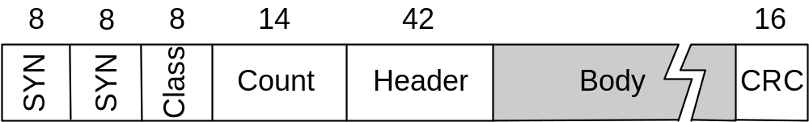
Approaches (cont)
Couter-based
  include payload length in header
  e.g., DDCMP
  problem: count field corrupted
  solution: catch when CRC fails

Slide 10
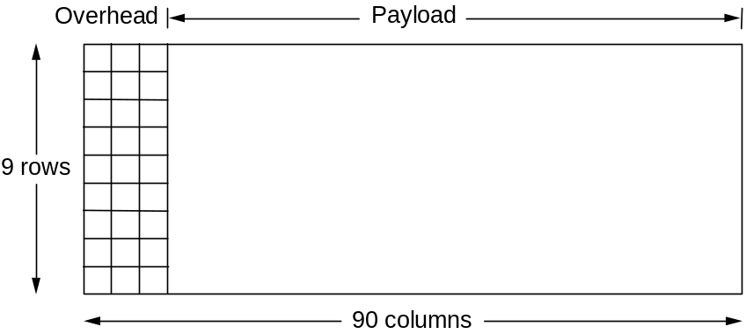
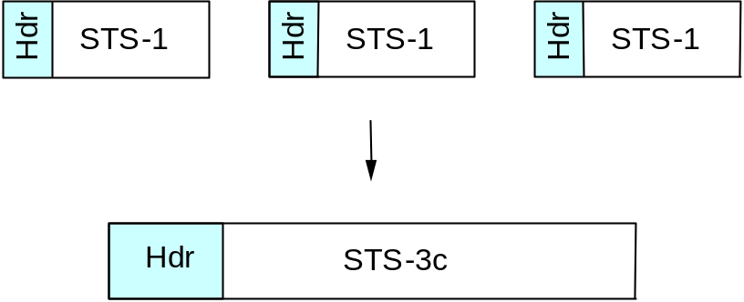
Approaches (cont)
Clock-based
  each frame is 125us long
  e.g., SONET: Synchronous Optical Network
  STS-n (STS-1 = 51.84 Mbps)

Slide 11
Cyclic Redundancy Check
Add k bits of redundant data to an n-bit message
  want k << n
  e.g., k = 32 and n = 12,000 (1500 bytes)
Represent n-bit message as n-1 degree polynomial
  e.g., MSG=10011010 as M(x) = x⁷ + x⁴ + x³ + x¹
Let k be the degree of some divisor polynomial
  e.g., C(x) = x³ + x² + 1

Slide 12
CRC (cont)
Transmit polynomial P(x) that is evenly divisible by C(x)
  shift left k bits, i.e., M(x)x^{k}
  subtract remainder of M(x)x^{k} / C(x) from M(x)x^{k}
Receiver polynomial P(x) + E(x)
  E(x) = 0 implies no errors
Divide (P(x) + E(x)) by C(x); remainder zero if:
  E(x) was zero (no error), or
  E(x) is exactly divisible by C(x)

Slide 13
Selecting C(x)
All single-bit errors, as long as the x^{k} and x⁰ terms have non-zero coefficients.
All double-bit errors, as long as C(x) contains a factor with at least three terms
Any odd number of errors, as long as C(x) contains the factor (x + 1)
Any ‘burst’ error (i.e., sequence of consecutive error bits) for which the length of the burst is less than k bits.
Most burst errors of larger than k bits can also be detected
See Table 2.6 on page 102 for common C(x)

Slide 14
Internet Checksum Algorithm
View message as a sequence of 16-bit integers; sum using 16-bit ones-complement arithmetic; take ones-complement of the result.
u_short
cksum(u_short *buf, int count)
{
register u_long sum = 0;
while (count--)
{
sum += *buf++;
if (sum & 0xFFFF0000)
{
/* carry occurred, so wrap around */
sum &= 0xFFFF;
sum++;
}
}
return ~(sum & 0xFFFF);
}

Slide 15
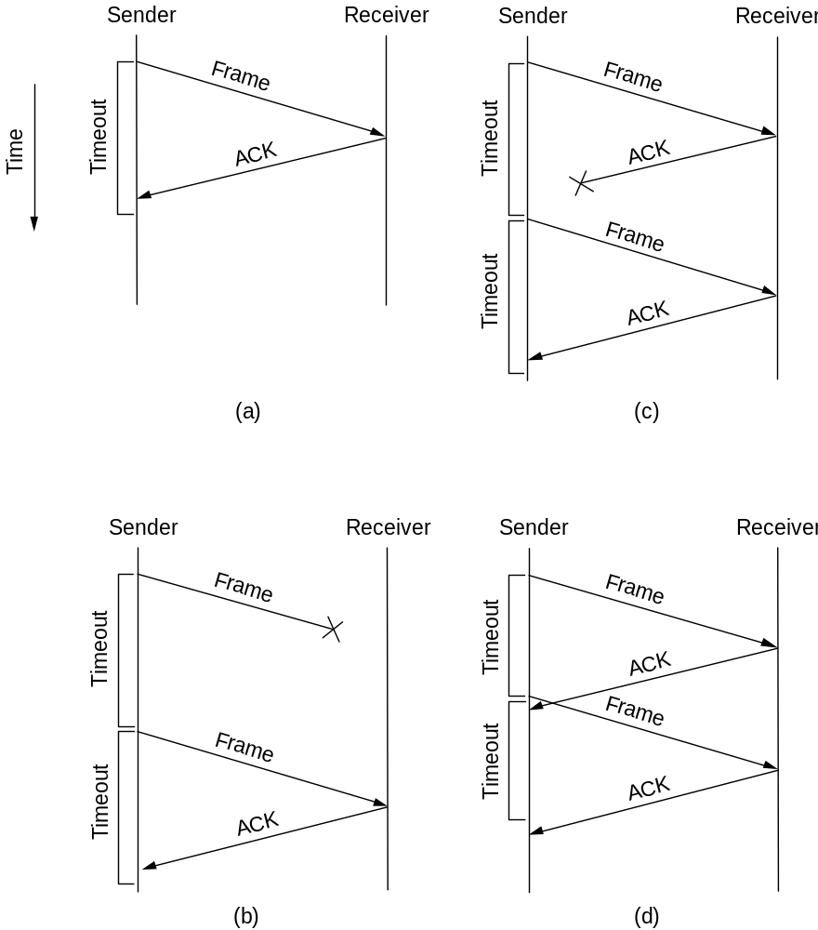
Acknowledgements & Timeouts

Slide 16
Stop-and-Wait
Sender
Receiver
Problem: keeping the pipe full
Example
  1.5Mbps link x 45ms RTT = 67.5Kb (8KB)
  1KB frames imples 1/8th link utilization

Slide 17
Sliding Window
Allow multiple outstanding (un-ACKed) frames
Upper bound on un-ACKed frames, called window
Sender
Receiver
…
ime
T
…

Slide 18
SW: Sender
Assign sequence number to each frame (SeqNum)
Maintain three state variables:
  send window size (SWS)
  last acknowledgment received (LAR)
  last frame sent (LFS)
Maintain invariant: LFS - LAR <= SWS
Advance LAR when ACK arrives
Buffer up to SWS frames
≤
SWS
…
…
LAR
LFS

Slide 19
SW: Receiver
Maintain three state variables
  receive window size (RWS)
  largest frame acceptable (LFA)
  last frame received (NFE)
Maintain invariant: LFA - LFR <= RWS
Frame SeqNum arrives:
  if LFR < SeqNum < = LFA accept
  if SeqNum < = LFR or SeqNum > LFA discarded
Send cumulative ACKs
≤
RWS
…
…
NFE
LFA

Slide 20
Sequence Number Space
SeqNum field is finite; sequence numbers wrap around
Sequence number space must be larger then number of outstanding frames
SWS <= MaxSeqNum-1 is not sufficient
  suppose 3-bit SeqNum field (0..7)
  SWS=RWS=7
  sender transmit frames 0..6
  arrive successfully, but ACKs lost
  sender retransmits 0..6
  receiver expecting 7, 0..5, but receives second incarnation of 0..5
SWS < (MaxSeqNum+1)/2 is correct rule
Intuitively, SeqNum “slides” between two halves of sequence number space

Slide 21
Concurrent Logical Channels
Multiplex 8 logical channels over a single link
Run stop-and-wait on each logical channel
Maintain three state bits per channel
  channel busy
  current sequence number out
  next sequence number in
Header: 3-bit channel num, 1-bit sequence num
  4-bits total
  same as sliding window protocol
Separates reliability from order

